Slide 1
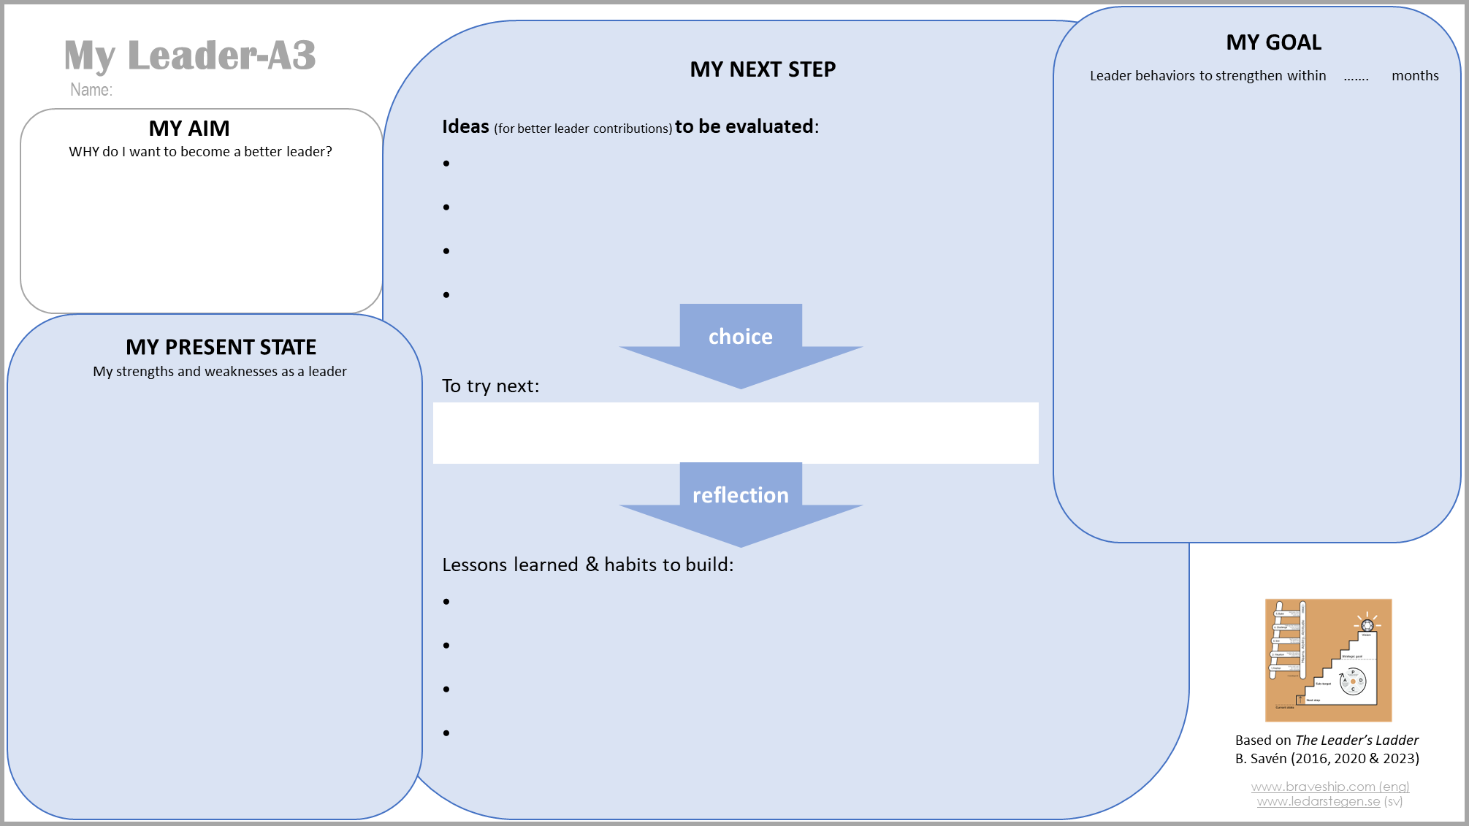
X
X
X
X
X
X
X
X

Slide 2
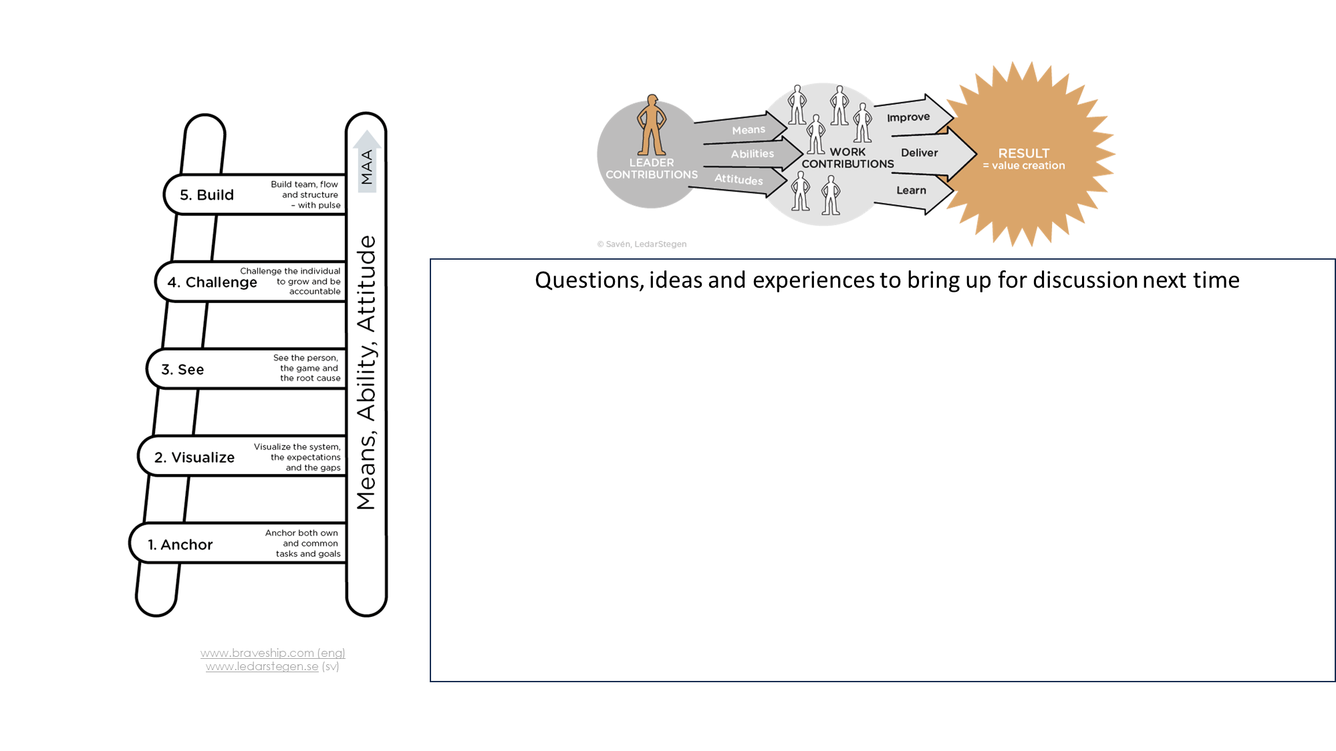
X

